Slide 1
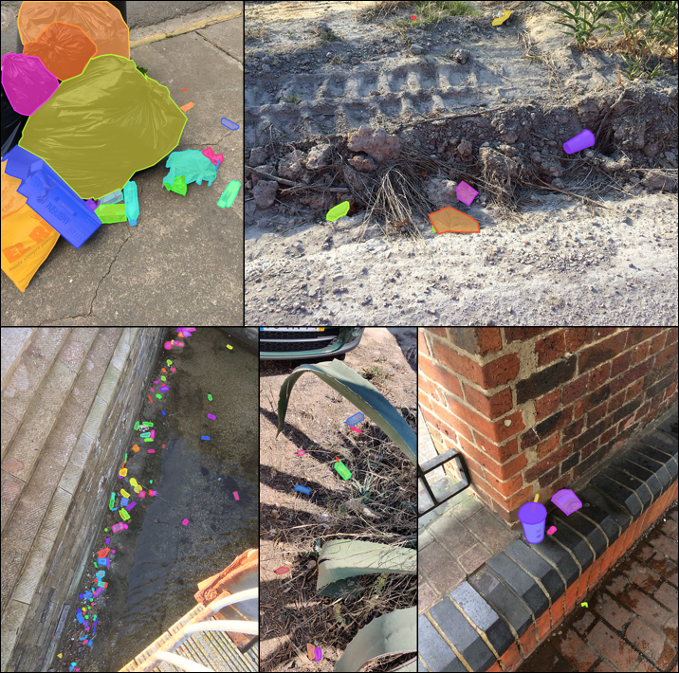

Trash Detection with Computer Vision
Julian Hernandez
California State University, Sacramento
ECS Pitch

Slide 2
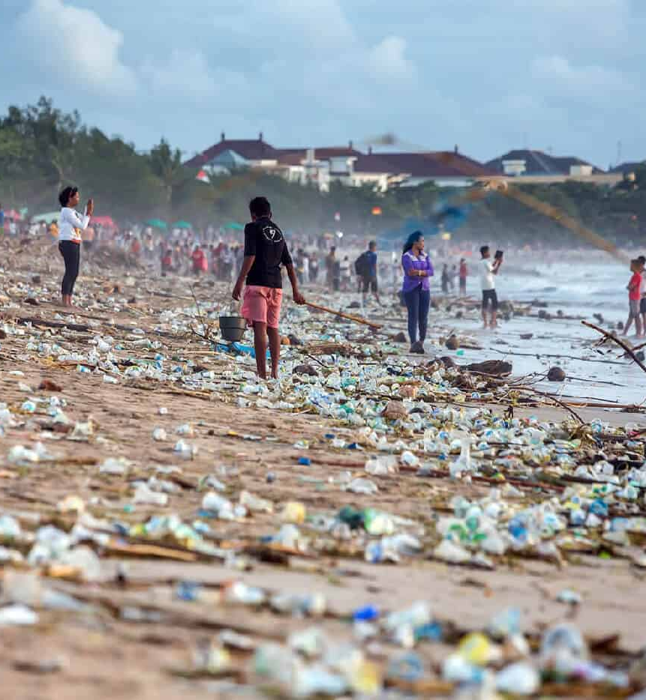
The Trash Problem
Plastic causes harm to wildlife
E-Waste contaminates ground and water systems
Municipal waste management costs billions each year
Responsible for 5% for green-house gas emissions

Slide 3
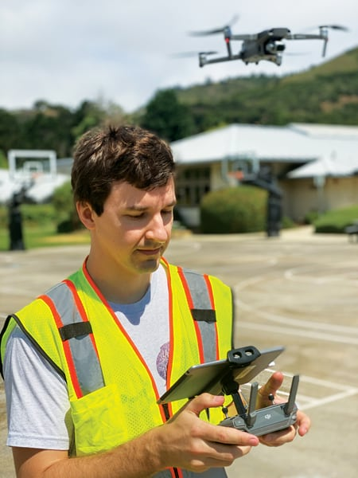
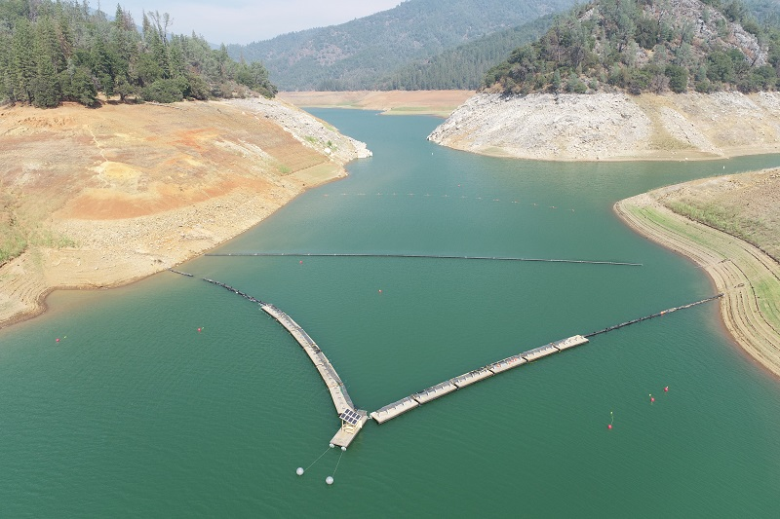
Regulatory Background
Statewide Trash Amendments set limits for trash for California inland surface waters, enclosed bays, estuaries and some CalTrans roadways [SFEI]
Track 1: Install full trash capture systems
Track 2: Use multiple systems for 100% equivalent trash removal
But monitoring systems must be developed

Slide 4
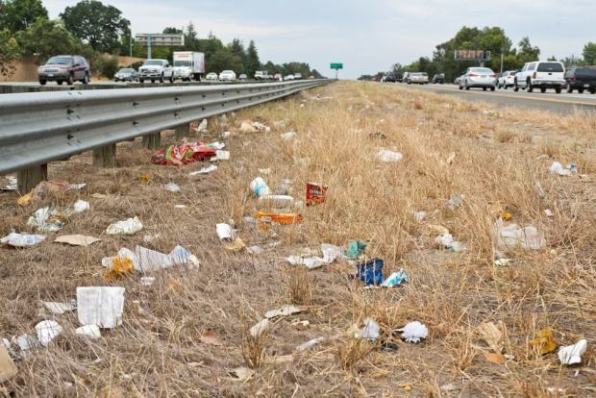
Current Methods
How do we measure trash now?
Qualitative: Multiple surveyors give the site a subjective score, averaging their results.
Fast but only gives a score from 1 to 12
Quantitative: Volume based approach is more precise but requires a lot of time and resources
Too slow: up to 1 hour for 100 feet of highway

Slide 5
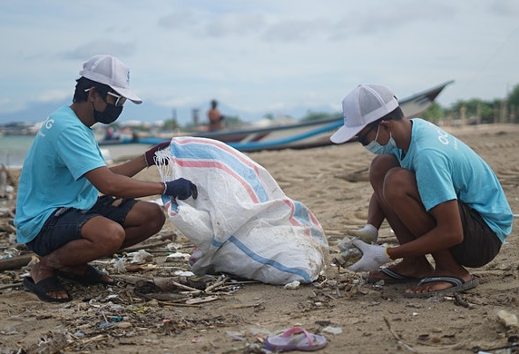
Trash Detection with Computer Vision
Sponsor volunteer clean ups to collect training data
Train a robust computer vision algorithm
Provide fast and accurate monitoring for CalTrans and others

Slide 6
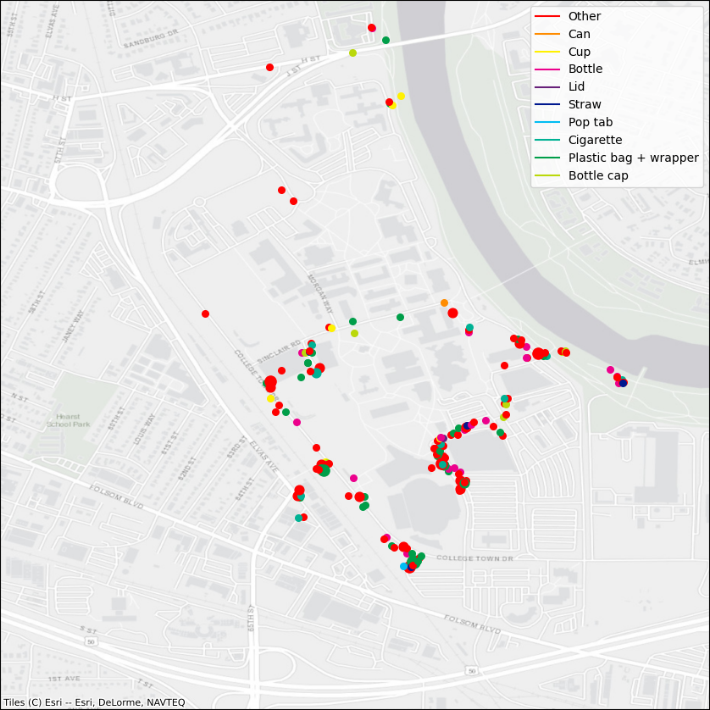
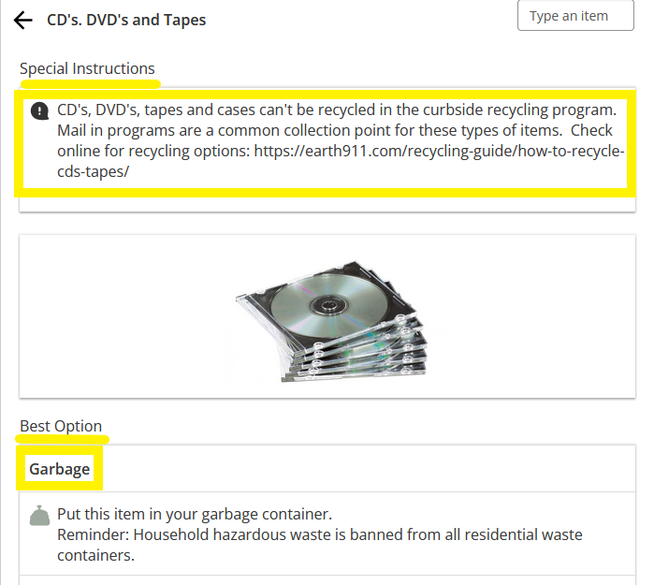
Completed Progress
McNair project: Pretrained algorithm was combined with geographic data
Senior Project: City specific disposal instructions from the Sacramento Waste Wizard
http://www.cityofsacramento.org/public-works/rsw/waste-wizard

Slide 7
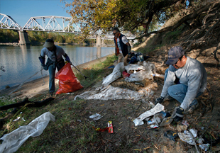
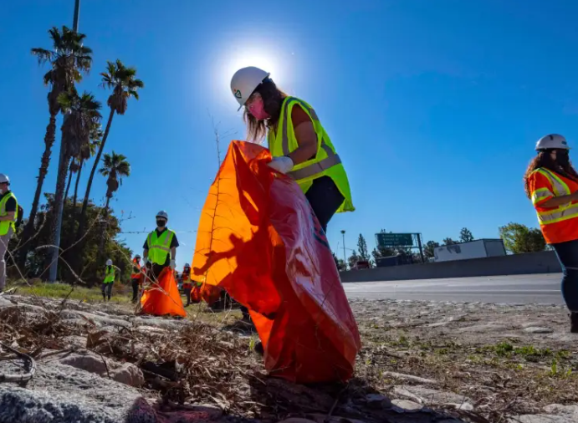
Next Steps
Scale up volunteer clean ups across the Sacramento Area
Continue training our algorithm to improve accuracy
Create an open database for this information to be hosted for data analysis

Slide 8
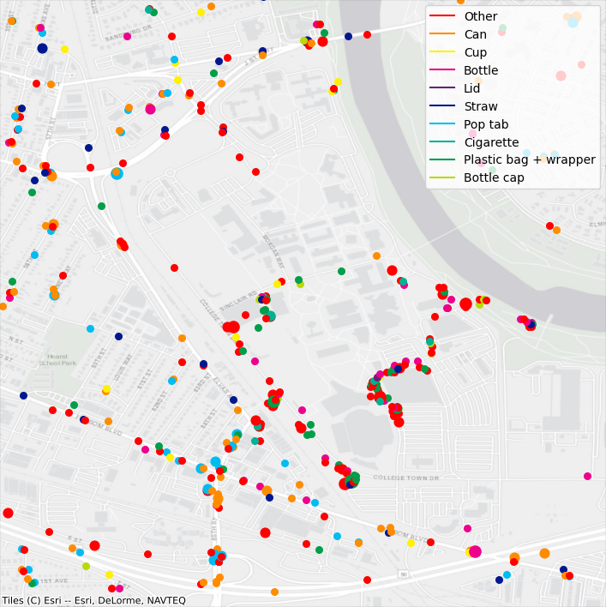
What insights could this data provide?
Volunteers can use their smartphone to precisely locate hazards for follow-up removal
Find what areas are most in need when cleaning events are planned
Identify hotspots for place new trashcans, and measure their effectiveness
Trash data from around CSUS from multiple clean-ups

Slide 9





The Project Team
Dr. Clark Fitzgerald - Professor in the College of Natural Sciences and Math is providing guidance and computational resources
Julian Hernandez, Travis Hammond, Bryan Burch, Christopher Allen,
Santiago Bermudez, Jeffrey de Jesus, Daniel Smagly, Kenta Miyahara
Experience: Intel, California Department of Transportation, and John Hopkins University Applied Physics Lab
Awards: CSUS Data Science Club leaders and a McNair Scholar

Slide 10
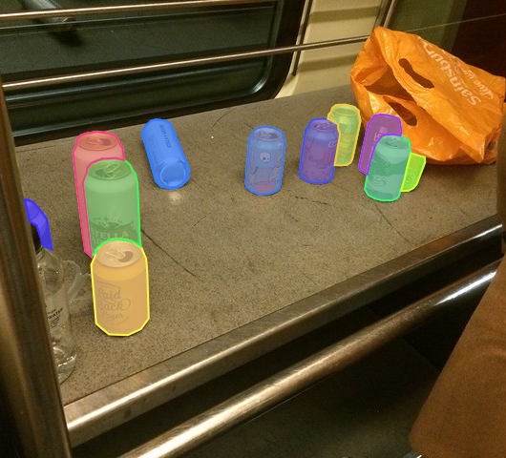

Questions?
References available by email julianofhernandez@csus.edu
https://linktr.ee/julian.hernandez

